Slide 1

Setting Up Your Automation Environment
Module 2

Slide 2
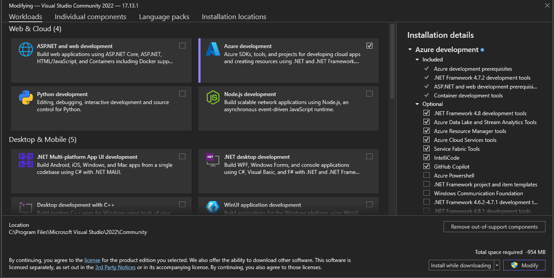

Installing Necessary Tools
Install Visual Studio (Community Edition) https://visualstudio.microsoft.com/downloads/
Install .NET SDK

Slide 3
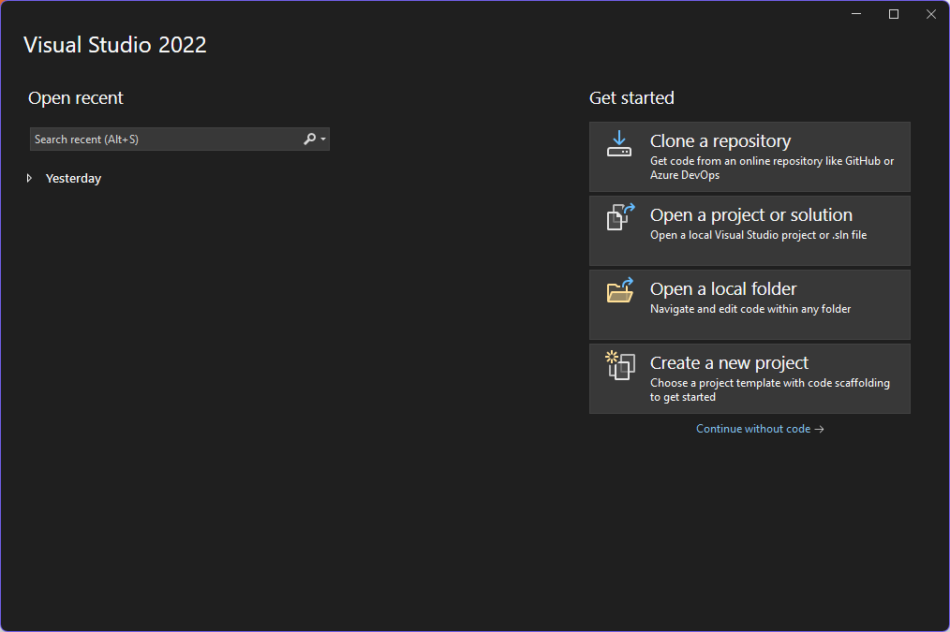
Creating Your First C# Selenium Project
Create new Project

Slide 4
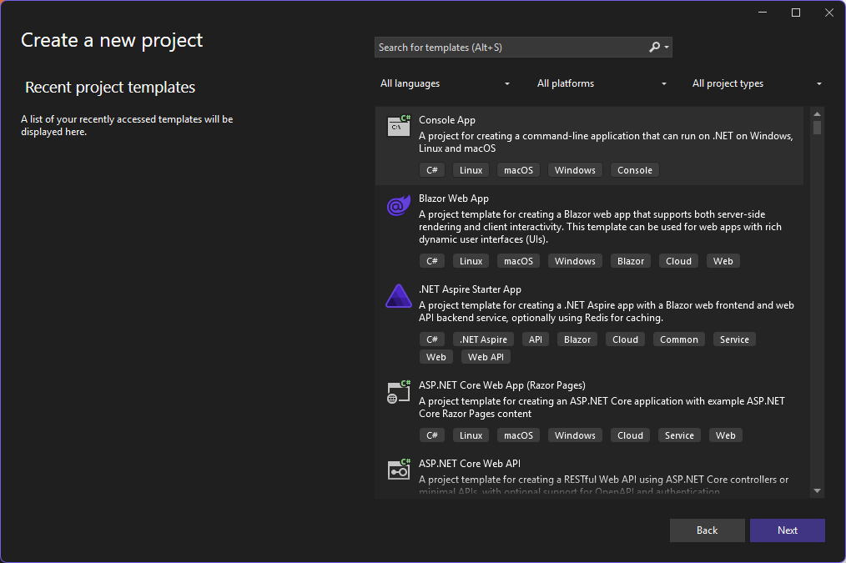
Creating Your First C# Selenium Project
Create new Project

Slide 5
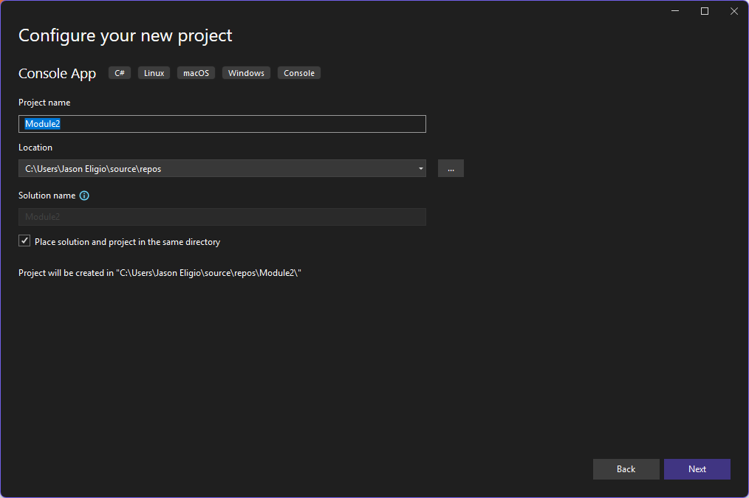
Creating Your First C# Selenium Project
Create new Project
Browse the location your cloned repository folder

Slide 6
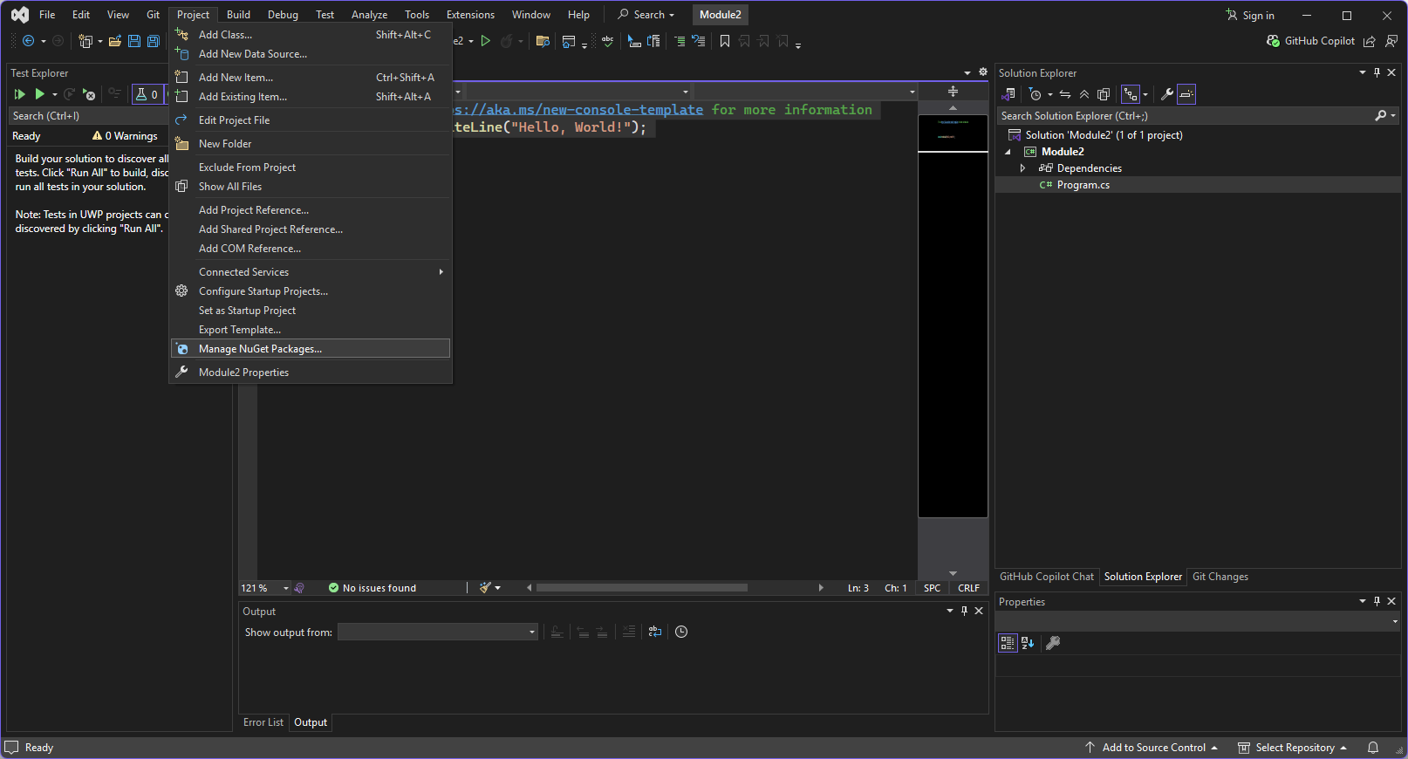
Creating Your First C# Selenium Project
Install Selenium

Slide 7
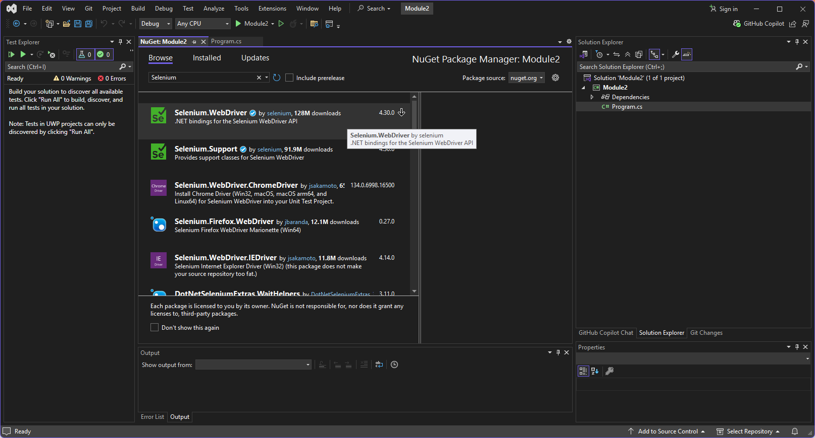
Creating Your First C# Selenium Project
Install Selenium

Slide 8
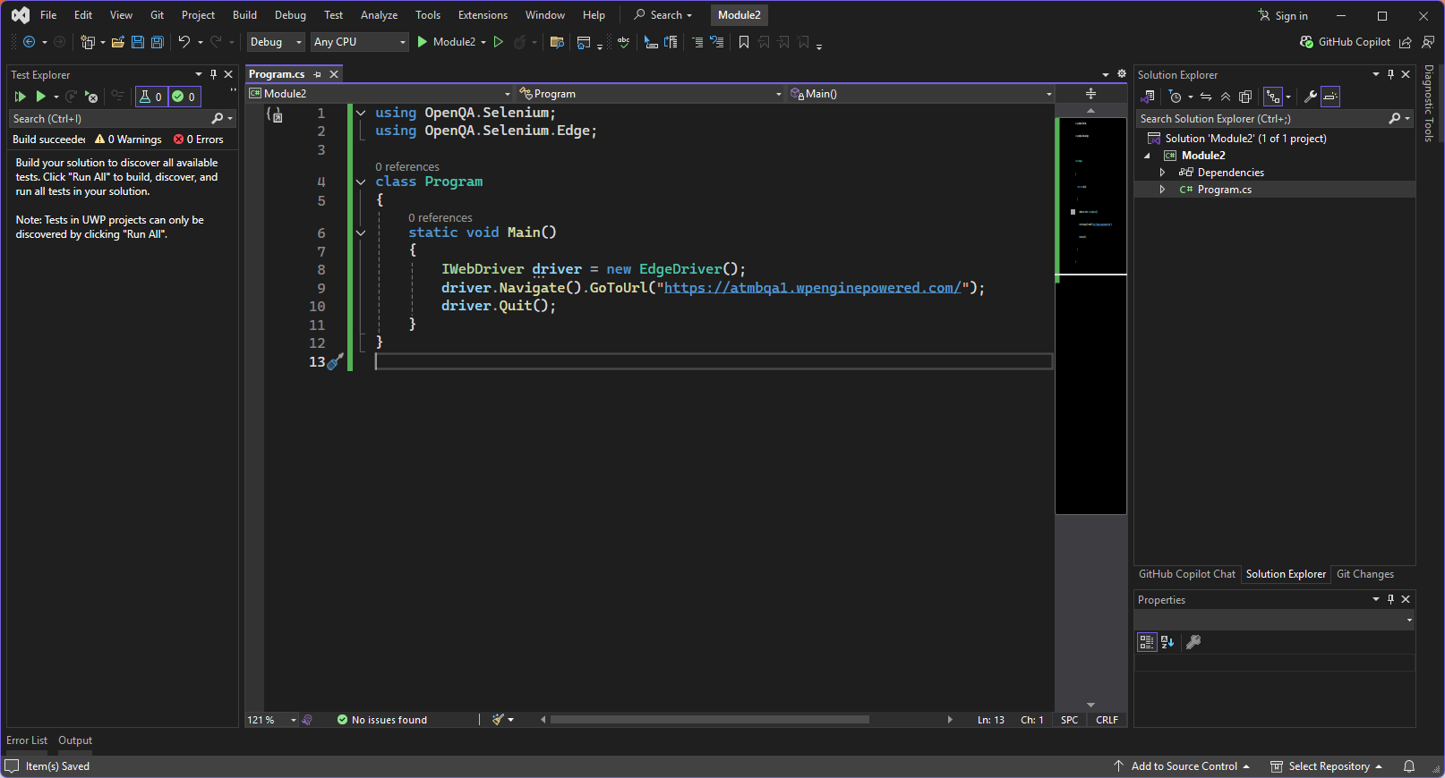
Creating Your First C# Selenium Project
Write basic Selenium WebDriver script

Slide 9
Hands-on Activity
Install Visual Studio (Community Edition) https://visualstudio.microsoft.com/downloads/
Install .NET SDK
Create a new console project named ‘Module2’
Write a selenium script for the following Test Steps
Push your code to your GitHub Repo using GitHub Desktop Application

Slide 10
Test Steps
Open Chrome Browser
Navigate to URL https://www.saucedemo.com/
Close Chrome Browser

